Slide 1
Introduction to Neural Network and Deep Learning
Đỗ Trọng Hợp
Khoa Khoa Học và Kỹ Thuật Thông Tin
Đại học Công Nghệ Thông Tin TP. Hồ Chí Minh

Slide 2
Introduction to Deep Learning

Slide 3
neuron
Size
Price
x
y

Slide 4
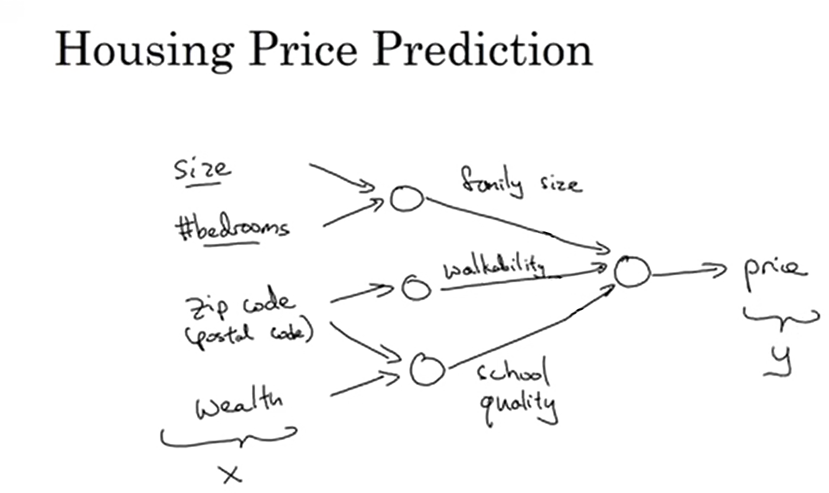
Notes:
For example, given Size and number of bedroom, the first node can estimate family size.
We just need to input X and Y, the middle part will be estimated by themselves.

Slide 5
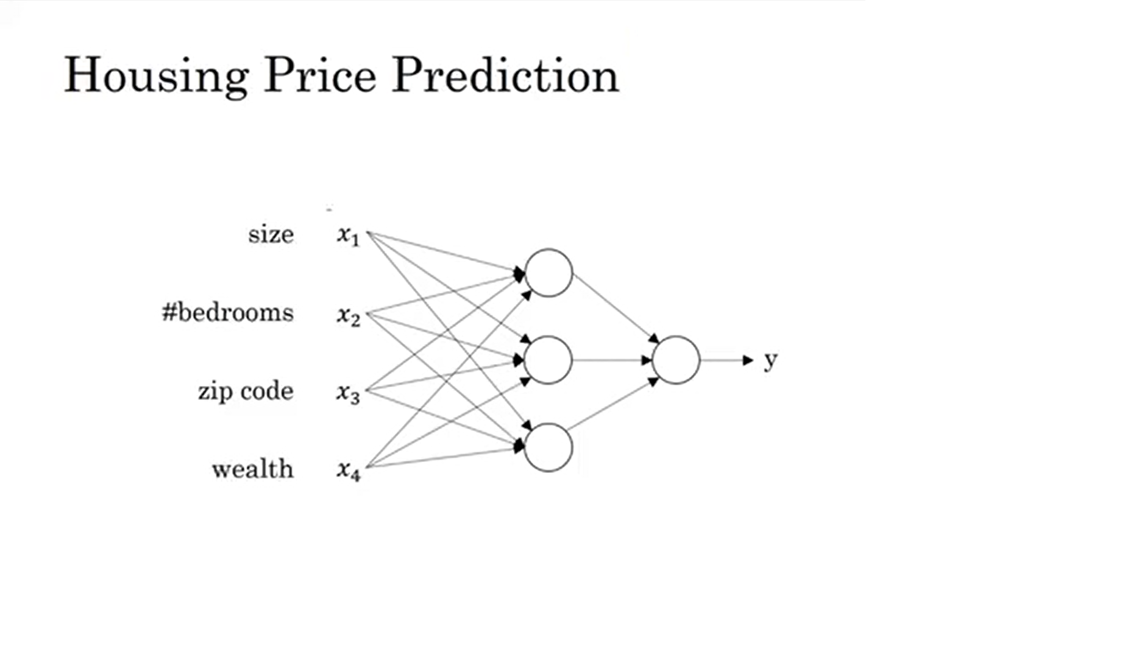
price
Notes:
This is what we really implement.
Each node takes all input from the previous layer.

Slide 6
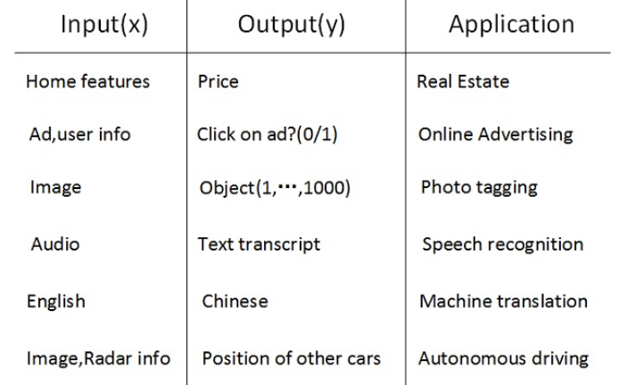
Supervised learning
Standard NN
CNN
RNN
Hybrid

Slide 7
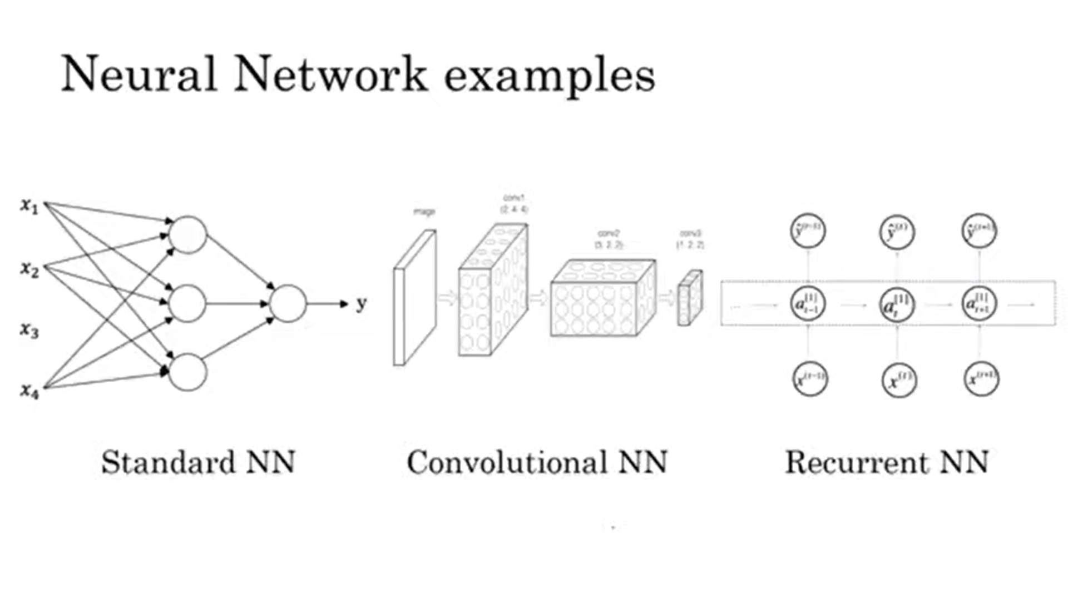

Slide 8
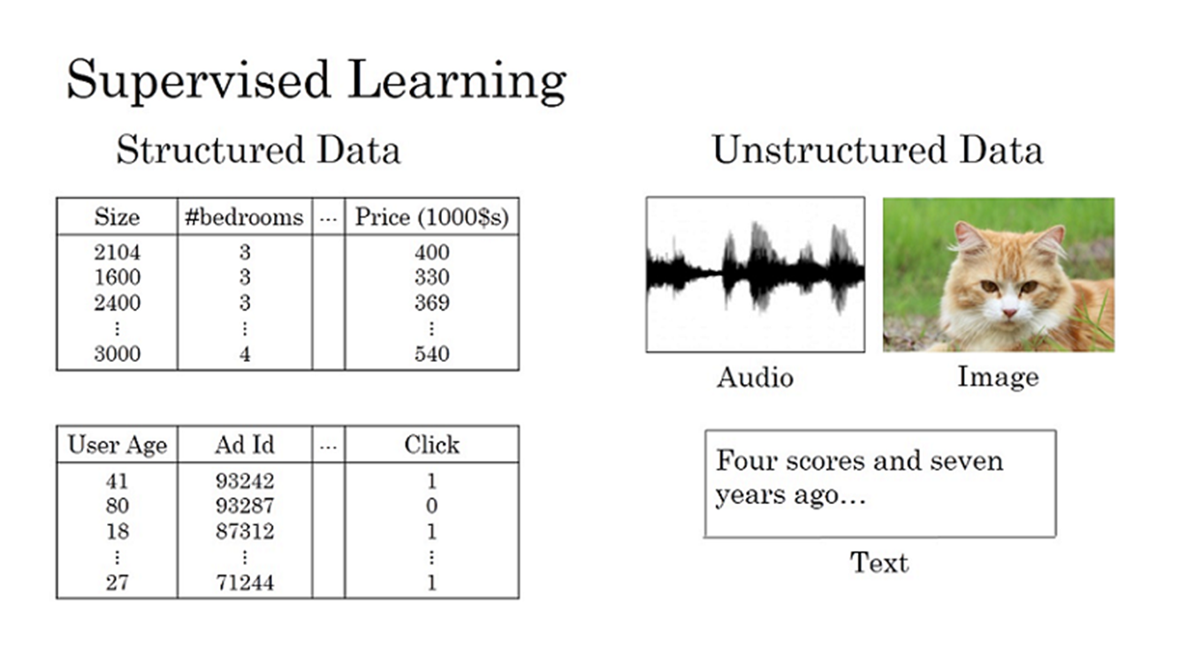
Notes:
Historically, it was much harder for computer to understand unstructured data compared to structured data.
While human was evolved to understand unstructured data very well.
Thanks to neural network, computers now are much better in interpreting unstructured data compared to just a few yeas ago.

Slide 9
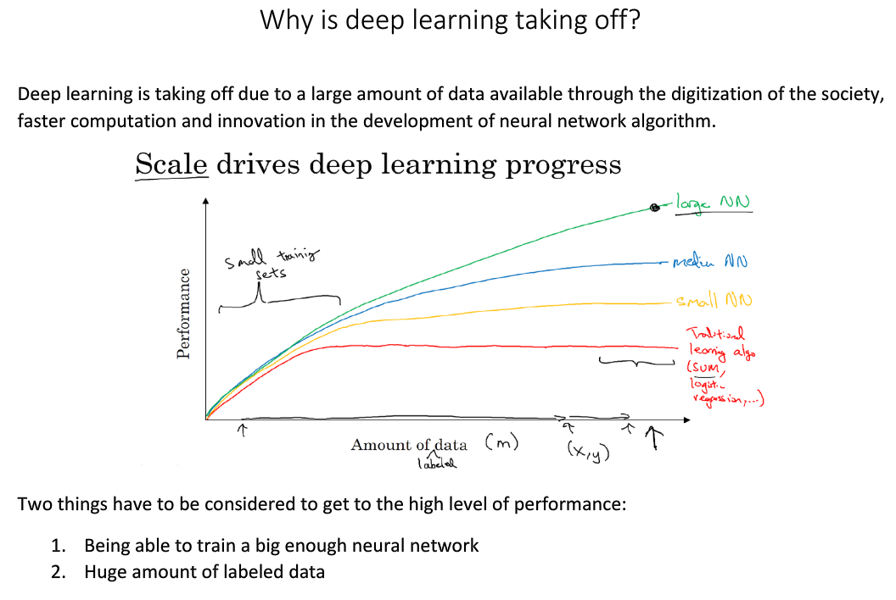

Slide 10
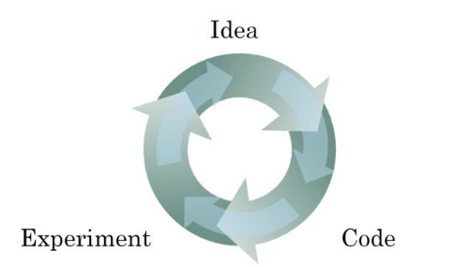
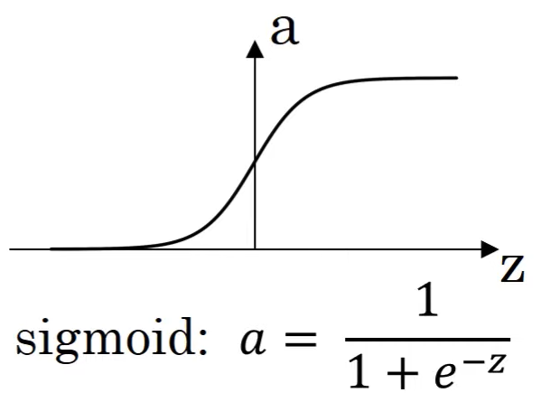
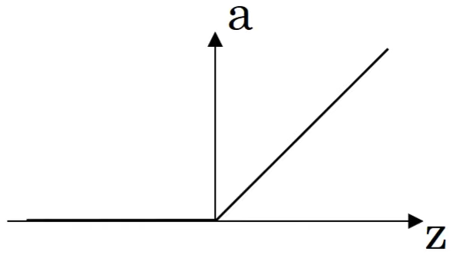
Scale drives deep learning progress
Data
Computation
Algorithm
Notes:
The process of training a neural network is iterative. Faster computation helps to iterate and improve new algorithm.

Slide 11
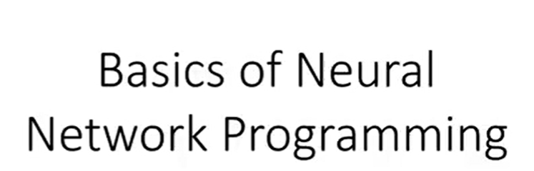

Slide 12
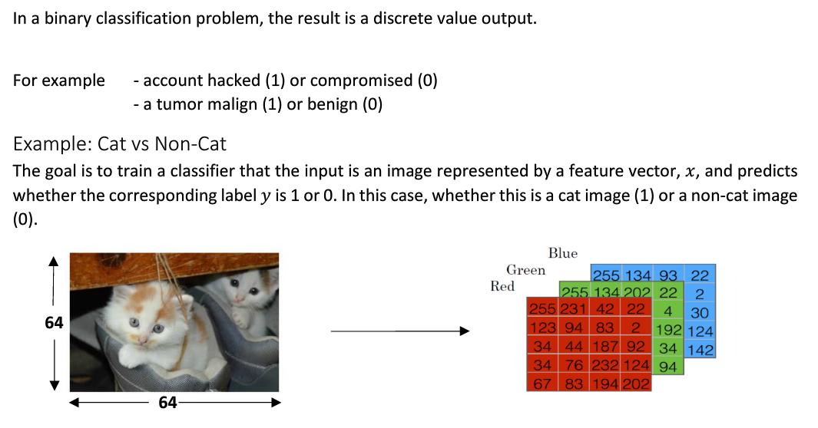
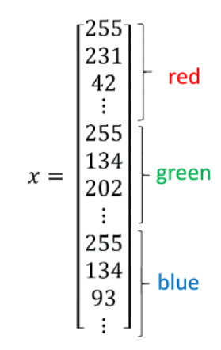
Binary classification

Slide 13
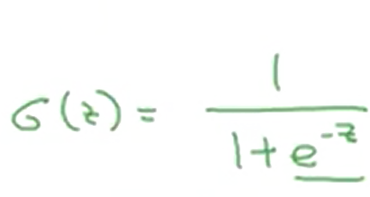
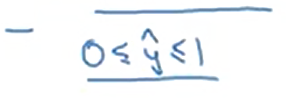
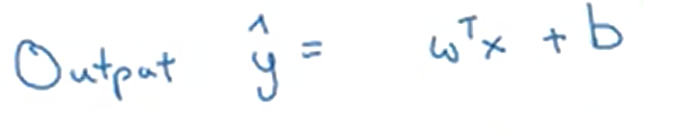

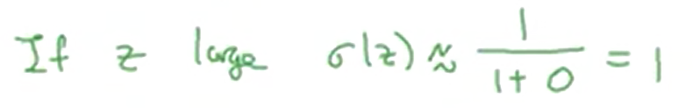

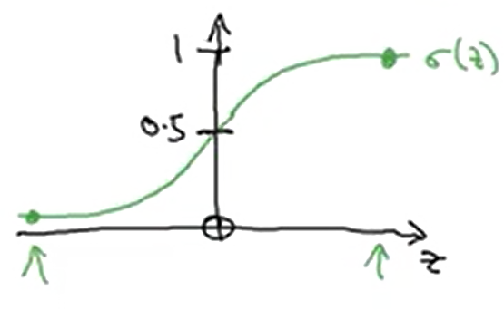
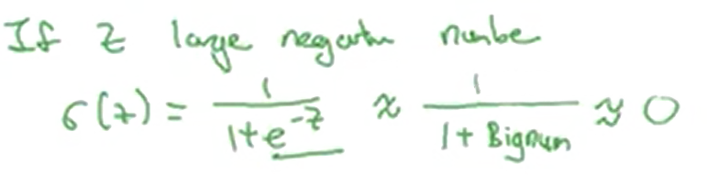
Notes:
Logistic regression is a supervised learning algorithm for binary classification problems.
So this is the logistic regression model. To change parameter w and b, we need to define a cost function.

Slide 14
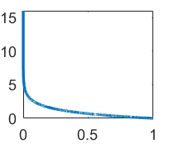
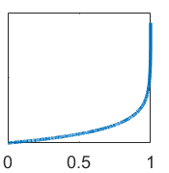
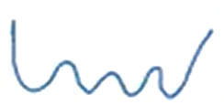
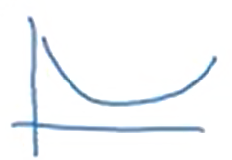
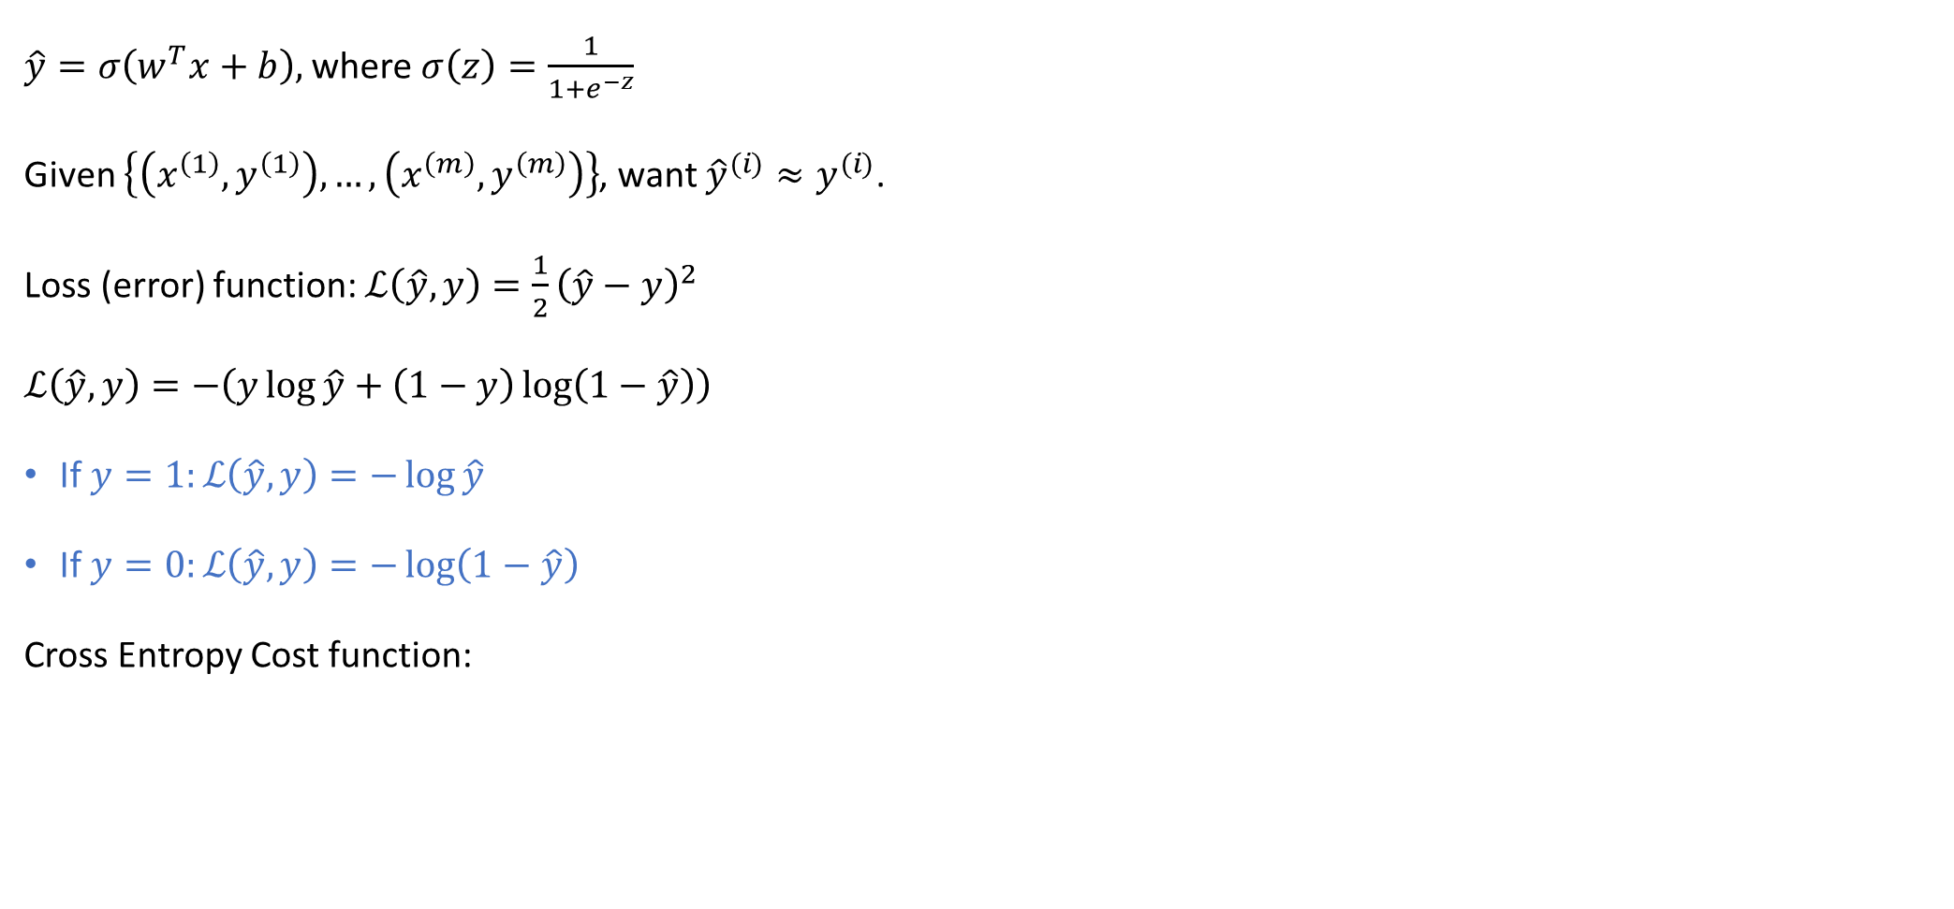
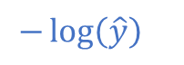
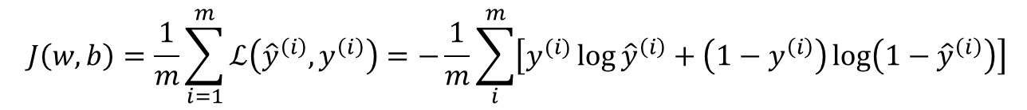
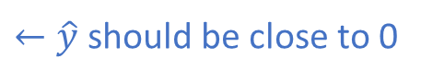
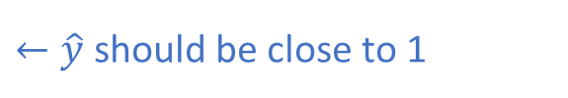
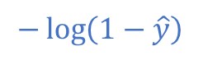
Logistic Regression cost function
$\hat{y}=σ\left(w^{T}x+b\right),$ where $σ\left(z\right)=\frac{1}{1+e^{−z}}$
Given $\left\{\left(x^{\left(1\right)},y^{\left(1\right)}\right),…,\left(x^{\left(m\right)},y^{\left(m\right)}\right)\right\}$, want ${\hat{y}}^{(i)}≈y^{(i)}$.
Loss (error) function: $ℒ\left(\hat{y},y\right)=\frac{1}{2}{\left(\hat{y}−y\right)}^{2}$
$ℒ\left(\hat{y},y\right)=−\left(y\log{\hat{y}}+\left(1−y\right)\log\left(1−\hat{y}\right)\right)$
If $y=1:ℒ\left(\hat{y},y\right)=−\log{\hat{y}}$
If $y=0:ℒ\left(\hat{y},y\right)=−\log\left(1−\hat{y}\right)$
Cross Entropy Cost function:
$$−\log\left(\hat{y}\right)$$
$$−\log\left(1−\hat{y}\right)$$
$←\hat{y}$ should be close to 1
$←\hat{y}$ should be close to 0
$$J\left(w,b\right)=\frac{1}{m}\sum_{i=1}^{m}{ℒ\left({\hat{y}}^{\left(i\right)},y^{\left(i\right)}\right)}=−\frac{1}{m}\sum_{i}^{m}{\left[y^{(i)}\log{{\hat{y}}^{\left(i\right)}+\left(1−y^{\left(i\right)}\right)\log\left(1−{\hat{y}}^{\left(i\right)}\right)}\right]}$$
Notes:
The loss function should be as small as possible.
The loss function was defined with respect to a single training example and measure how well you’re doing on a single training example.
We define a cost function, which measures how well you’re doing on the entire training set.
The cost function is the cost of the parameter w and b.
In training logistic regression model, we’re going to find parameter w and b that minimize the overall cost function J.

Slide 15
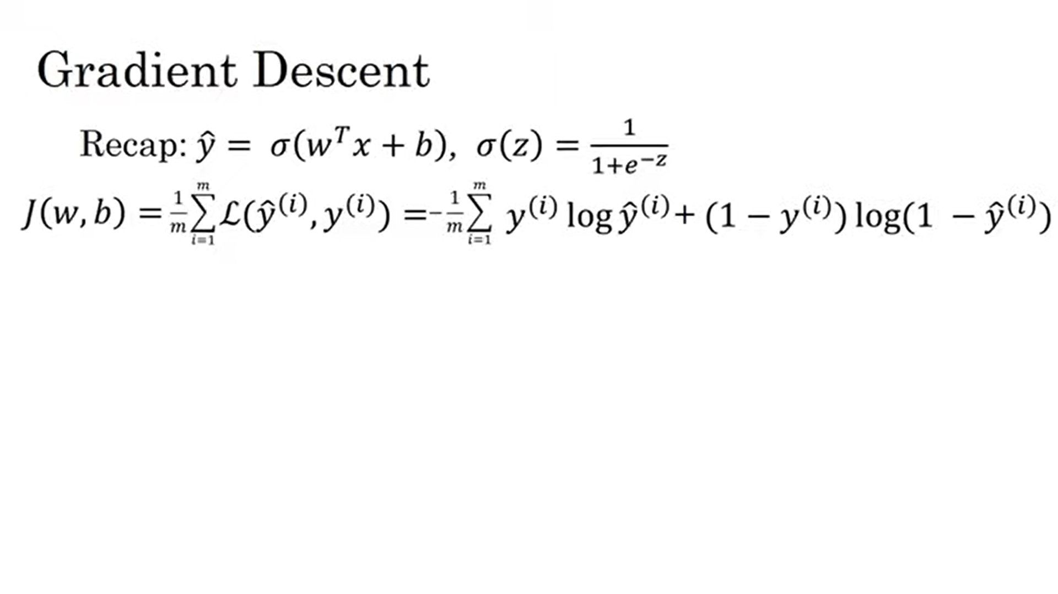
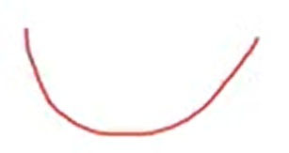
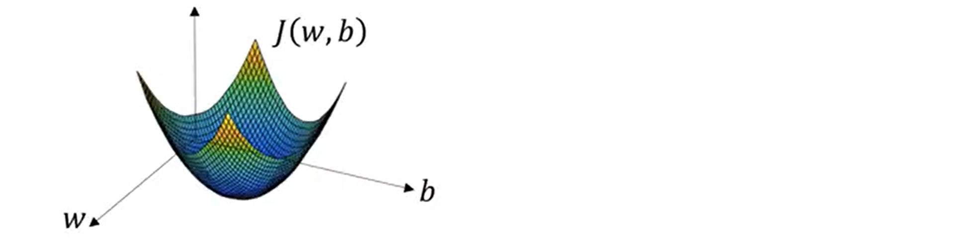
Global optimum

Slide 16
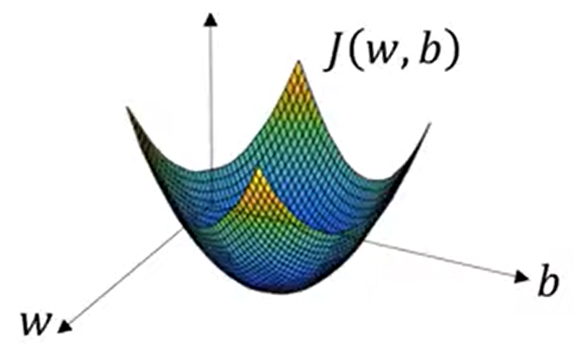

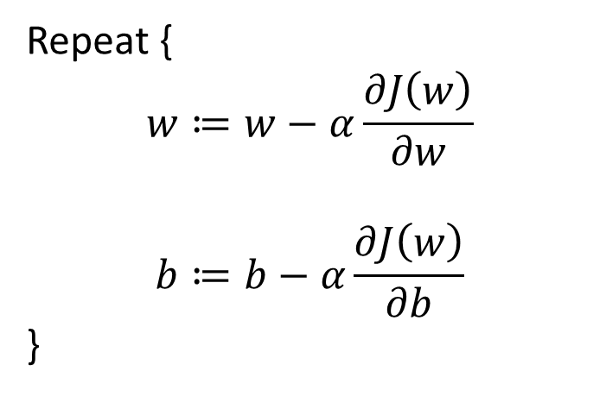
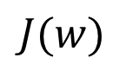
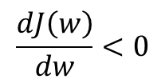
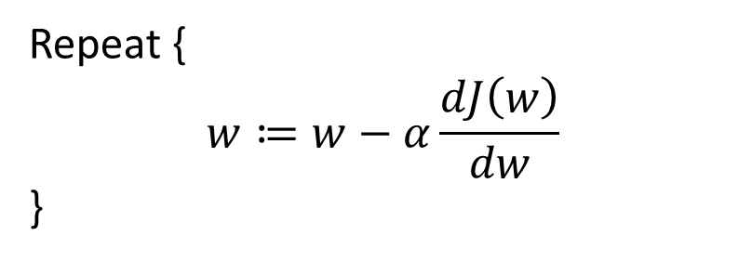
Gradient Descent
Learning rate
$$\frac{dJ\left(w\right)}{dw}<0$$
$$J(w)$$
Repeat {
$$w≔w−α\frac{dJ\left(w\right)}{dw}$$
}
Update
$$w$$
Repeat {
$$w≔w−α\frac{∂J\left(w\right)}{∂w}$$
$$b≔b−α\frac{∂J\left(w\right)}{∂b}$$
}

Slide 17
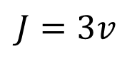
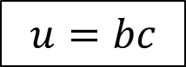
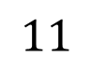
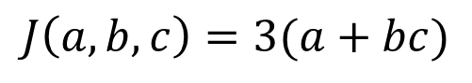
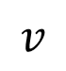
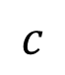

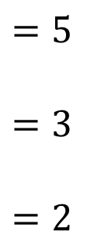
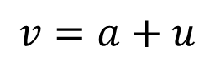
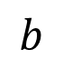
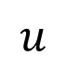
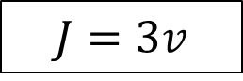
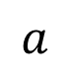
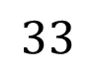
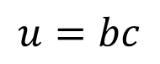


Computation Graph
$$J\left(a,b,c\right)=3(a+bc)$$
$$u=bc$$
$$u$$
$$v=a+u$$
$$v$$
$$J=3v$$
$$J$$
$$a$$
$$=5$$
$$=3$$
$$=2$$
$$11$$
$$33$$
$$b$$
$$6$$
$$v=a+u$$
$$J=3v$$
$$u=bc$$
$$c$$
Notes:
The computation of neural network is organized in terms of a forward path (forward propagation step) used to compute the output of the neural network followed by a backward path (backward propagation step) used to compute the gradient (the partial derivative).
The computation graph explains why it is organized this way.
The computation Graph comes in handy when there is an ouput (J in this case) that you want to optimize.
Through left to right path, you can compute the value of J.
We’ll see in next slide that we can compute the derivative over the right to left path.

Slide 18






















Derivatives with Computation Graphs
Chain rule
$$F(x) = f(g(x))$$
$$da$$
$$a$$
$$=5$$
$$=3$$
$$=2$$
$$11$$
$$33$$
$$db$$
$$b$$
$$6$$
$$v=a+u$$
$$J=3v$$
$$u=bc$$
$$c$$
$$dv$$
$$dc$$
$$du$$
$$\frac{∂J}{∂a}=\frac{∂J}{∂v}\frac{∂v}{∂a}$$
$$\frac{∂J}{∂u}=\frac{∂J}{∂v}\frac{∂v}{∂u}$$
$\frac{∂J}{∂b}=\frac{∂J}{∂u}$ $\frac{∂u}{∂b}$
$\frac{∂J}{∂c}=\frac{∂J}{∂u}$ $\frac{∂u}{∂c}$
$$da$$
3
1
$$du$$
3
1
$$db$$
3
2
$$dc$$
3
3

Slide 19







Logistic Regression Radient descent
Minimize $ℒ$
Notes:
In this slide, we’ll see how to derive gradient descent for logistic regression using computation graph.
Actually, using computation graph is overkill in this case but it’ll help us get familiar with the idea.

Slide 20








$$dz=\frac{∂L}{∂z}=\frac{∂L}{∂a}\frac{∂a}{∂z}$$
$$da=\frac{∂L}{∂a}=−\frac{y}{a}+\frac{1−y}{1−a}$$
$$=a−y$$
$$a\left(1−a\right)$$
$w_{1}≔w_{1}−α dw_{1}$
$w_{2}≔w_{2}−α dw_{2}$
$b≔b−α db$
$$dw_{1}=\frac{∂L}{∂w_{1}}=\frac{∂L}{∂z}\frac{∂z}{∂w_{1}}=x_{1}dz$$
$$db=dz$$
$$dw_{2}=x_{2}dz$$

Slide 21







Gradient Descent on m Examples
$$\frac{∂J}{∂w_{i}}=\frac{1}{m}\sum_{i=1}^{m}{\frac{∂L}{∂w_{i}}}=\frac{1}{m}\sum_{i=1}^{m}{dw_{i}^{(i)}}$$

Slide 22

Gradient Descent on m Examples
J=0; dw1=0; dw2=0; db=0;
for i = 1 to m
z(i) = wx(i)+b;
a(i) = sigmoid(z(i));
J += -[y(i)log(a(i))+(1-y(i)）log(1-a(i));
dz(i) = a(i)-y(i);
dw1 += x1(i)dz(i);
dw2 += x2(i)dz(i);
db += dz(i);
J /= m;
dw1 /= m;
dw2 /= m;
db /= m;

Slide 23


Vectorizing Logistic Regression
dw = np.zeros(n_{X},1))
$$dw+=x^{\left(i\right)}dz^{(i)}$$
dw /=m

Slide 24









Vetorizing Logistic Regression

Slide 25



Z = np.dot(w.T,X) + b
A = sigmoid(Z)
dZ = 1/m*(A-Y)
dw = np.dot(X,dZ.T)
db = np.sum(dZ)
w = w - alpha*dw
b = b - alpha*db

Slide 26
One hidden layer Neural Network

Slide 27




What is neural network?

Slide 28







$z_{1}^{[1]}=w_{1}^{\left[1\right]T}x+b_{1}^{[1]}$
$a_{1}^{[1]}=σ\left(z_{1}^{[1]}\right)$
$$a_{i}^{[l]}$$
layer
node in layer
$z_{2}^{[1]}=w_{2}^{\left[1\right]T}x+b_{2}^{[1]}$
$a_{2}^{[1]}=σ\left(z_{2}^{[1]}\right)$

Slide 29








$$(4,3)$$
$$\left[\begin{aligned}w_{1}^{\left[1\right]T} \\ w_{2}^{\left[1\right]T} \\ w_{3}^{\left[1\right]T} \\ w_{4}^{\left[1\right]T}\end{aligned}\right]$$
$$\left[\begin{aligned}x_{1} \\ x_{2} \\ x_{3}\end{aligned}\right]$$
$$+\left[\begin{aligned}b_{1}^{[1]} \\ b_{2}^{[1]} \\ b_{3}^{[1]} \\ b_{4}^{[1]}\end{aligned}\right]$$
$$z^{[1]}=$$
$$W^{[1]}$$
$$b^{[1]}$$

Slide 30






$$(4,1) (4,3) (3,1) (4,1)$$
$$(4,1) (4,1)$$
$\left(1,1\right) \left(1,4\right) (4,1) (1,1)$
$$(1,1) (1,1)$$

Slide 31





Slide 32







$$tanh:a=\frac{e^{z}−e^{−z}}{e^{z}+e^{−z}}$$
ReLu: $a=\max\left(0,z\right)$
Leaky ReLu: $a=\max\left(0.01z,z\right)$
Notes:
For binary classification, we can use sigmoid in the output layer.
For hidden layer, we should use other activation function (tank is always better than sigmoid)

Slide 33







With linear activation function, the outputs on later layers are also linear combination of the input. So the hidden layer (even many of them) has no meaning.
Notes:
If we use linear activation function, the ouput on later layer is also linear combination of the input. So the hidden layer (even many of them) has no meaning.

Slide 34







Derivatives of activation function
$$g^{′}\left(z\right)=g\left(z\right)\left(1−g\left(z\right)\right)=a(1−a)$$
$$g^{′}\left(z\right)=1−{\left(g\left(z\right)\right)}^{2}=1−a^{2}$$
$$tanh:a=\frac{e^{z}−e^{−z}}{e^{z}+e^{−z}}$$
$$g^{′}\left(z\right)=\left\{\begin{aligned}0.01 if z<0 \\ 1 if z≥0\end{aligned}\right.$$
$$g^{′}\left(z\right)=\left\{\begin{aligned}0 if z<0 \\ 1 if z≥0\end{aligned}\right.$$
ReLu: $a=\max\left(0,z\right)$
Leaky ReLu: $a=\max\left(0.01z,z\right)$

Slide 35








Gradient descent for neural network
$$n^{[0]}$$
$$n^{[1]}$$
$$n^{[2]}$$
$$\left(n^{1},n^{0}\right) \left(n^{1},1\right) \left(n^{\left[2\right]},n^{\left[1\right]}\right) (n^{\left[1\right]},1)$$
Parameter: $W^{\left[1\right]} , b^{[1]} , { W}^{[2]} , { b}^{[2]}$
Cost function:
$Repeat \{$
Compute $a^{\left[1\right]},z^{\left[1\right]},a^{\left[2\right]},z^{[2]}$
$dW^{[2]}=\frac{∂J}{∂W^{[2]}} , db^{[2]}=\frac{∂J}{∂b^{[2]}} ,dW^{[1]}=\frac{∂J}{∂W^{[1]}} , db^{[1]}=\frac{∂J}{∂b^{[1]}}$
$W^{[2]}=W^{[2]}−α dW^{\left[2\right]} , b^{\left[2\right]}=b^{\left[2\right]}−α db^{[2]}$
$W^{[2]}=W^{[2]}−α dW^{\left[2\right]} , b^{\left[2\right]}=b^{\left[2\right]}−α db^{[2]}$
$\}$

Slide 36







Gradient descent for neural network
$$\left(1,n^{\left[1\right]}\right)$$
$da^{[2]}=\frac{∂L}{∂a^{[2]}}=−\frac{y}{a^{[2]}}+\frac{1−y}{1−a^{[2]}}$
$dz^{[2]}=\frac{∂L}{∂z^{[2]}}=\frac{∂L}{∂a^{[2]}}\frac{∂a^{[2]}}{∂z^{[2]}}=da^{\left[2\right]}\left(a\left(1−a\right)\right)=a^{[2]}−y$
$dW^{[2]}=\frac{∂L}{∂W^{[2]}}=\frac{∂L}{∂z^{[2]}}\frac{∂z^{[2]}}{∂W^{[2]}}=dz^{[2]}{a^{\left[1\right]}}^{T}$
$db^{[2]}=\frac{∂L}{∂b^{[2]}}=\frac{∂L}{∂z^{[2]}}\frac{∂z^{[2]}}{∂b^{[2]}}=dz^{[2]}$
$da^{[1]}=\frac{∂L}{∂a^{[1]}}=\frac{∂L}{∂z^{[2]}}\frac{∂z^{[2]}}{∂a^{[1]}}={W^{\left[2\right]}}^{T}dz^{[2]}$
$dz^{[1]}=\frac{∂L}{∂z^{[1]}}=\frac{∂L}{∂a^{[1]}}\frac{∂a^{[1]}}{∂z^{[1]}}=da^{\left[1\right]}{g^{\left[1\right]}}^{′}\left(z^{\left[1\right]}\right)={W^{\left[2\right]}}^{T}dz^{[2]}$* ${g^{\left[1\right]}}^{′}\left(z^{\left[1\right]}\right)$
Same goes for $dW^{[1]}$ and $db^{[1]}$
$$\left(n^{\left[1\right]},1\right)$$
$$\left(n^{\left[1\right]},1\right)$$
$$\left(1,1\right)$$

Slide 37

Summary of gradient descent for neural network

Slide 38

If you initialize weights to zeros, all rows in matrix $W$ will be the same.

Slide 39


Slide 40
Deep L-Layer Neural Network

Slide 41


Slide 42


Slide 43


Deep neural network notation

Slide 44





Forward Propagation in a Deep Network
Vectorizing across m training example

Slide 45
Implement forward propagation
def forwardprop(A_prev, W, b, activation):
Z = np.dot(W, A_prev) + b
if activation == "sigmoid":
A = sigmoid(Z)
elif activation == "relu":
A = relu(Z)
elif activation == "tanh":
A = tanh(Z)
cache = (Z, W)
return A, cache
Linear forward
Activation forward

Slide 46

Implement forward propagation
Output layer L
ReLu
Sigmoid
def L_model_forward(X, parameters):
A = X
for l in range(1, L):
A_prev = A
A, cache = forwardprop(A_prev, W_l, b_l, activation= 'relu')
AL, cache = forwardprop(A, W_L, b_L, activation= 'sigmoid')
return AL, caches

Slide 47













Backward Propagation in a Deep Network
……
$$da^{\left[L−1\right]}$$
$$dz^{\left[L\right]}$$
$$da^{\left[L\right]}$$
Input $da^{[l]}$
$$dW^{\left[L\right]}$$
$$db^{\left[L\right]}$$
With cross-entropy cost function:
$$da^{[L]}=\frac{∂L}{∂a^{[L]}}=−\frac{y}{a^{[L]}}+\frac{1−y}{1−a^{[L]}}$$

Slide 48





Vectorization of backward Propagation in a Deep Network
With cross-entropy cost function:
$$dA^{[L]}=\frac{∂L}{∂A^{[L]}}=−\frac{Y}{A^{[L]}}+\frac{1−Y}{1−A^{[L]}}$$

Slide 49
Implement backward propagation
def backprop(dA, cache, activation):
Z, W = cache
if activation == "relu":
dZ = relu_backward(dA, Z)
elif activation == "sigmoid":
dZ = sigmoid_backward(dA, Z)
elif activation == "tanh":
dZ = tanh_backward(dA, Z)
dA_prev, dW, db = linear_backward(dZ, A_prev, W)
return dA_prev, dW, db

Slide 50

Implement backward propagation
With cross-entropy cost function:
Output layer L
$$da^{[L]}=\frac{∂L}{∂a^{[L]}}=−\frac{y}{a^{[L]}}+\frac{1−y}{1−a^{[L]}}$$
ReLu
Sigmoid
def L_model_backward(AL, Y, caches):
# Initializing the backpropagation
dAL = - (Y/AL) + (1-Y)/(1-AL)
dA_pre, dW_L, db_L = backprop(dAL, caches[L], activation = "sigmoid")
for l in reversed(range(L-1)):
dA_pre, dW_l, db_l = backprop(dA_pre, caches[l], activation = "relu")
return [dW, db] of all layers

Slide 51





Implement backward propagation
def relu_backward(dA, Z):
dZ = dA
dZ[Z <= 0] = 0
return dZ
def sigmoid_backward(dA, Z):
A = 1/(1+np.exp(-Z))
dZ = dA * A * (1-A)
return dZ
def tanh_backward(dA, Z):
A = 1/(1+np.exp(-Z))
dZ = dA * (1-A*A)
return dZ
$$g^{′}\left(z\right)=\left\{\begin{aligned}0 if z<0 \\ 1 if z≥0\end{aligned}\right.$$
ReLu: $a=\max\left(0,z\right)$
$$g^{′}\left(z\right)=g\left(z\right)\left(1−g\left(z\right)\right)=a(1−a)$$
$$g^{′}\left(z\right)=1−{\left(g\left(z\right)\right)}^{2}=1−a^{2}$$
$$tanh:a=\frac{e^{z}−e^{−z}}{e^{z}+e^{−z}}$$

Slide 52
Implement backward propagation
def linear_backward(dZ, A_prev, W):
m = A_prev.shape[1]
dW = np.dot(dZ, A_prev.T)/m
db = dZ.sum(axis = 1, keepdims = True)/m
dA_prev = np.dot(W.T, dZ)
return dA_prev, dW, db

Slide 53
Implementation methodology
Initialize parameters / Define hyperparameters
Loop for num_iterations:
Forward propagation
Compute cost function
Backward propagation
Update parameters (using parameters, and grads from backprop)
Use trained parameters to predict labels

Slide 54
Implement forward and backward propagation
Linear forward
Activation forward
Activation backward
Linear backward

Slide 55
Implement forward and backward propagation
Activation backward
Linear backward

Slide 56


layer L
$$A^{[L]}$$

Slide 57

Linear Forward
Sigmoid
Forward
Sigmoid Backward
Linear
Forward

Slide 58

Backward Propagation in a Deep Network

Slide 59


Intuition about deep representation

Slide 60

Building blocks of deep neural networks

Slide 61


Building blocks of deep neural networks

Slide 62

Implement cost function
$$J\left(w,b\right)=\frac{1}{m}\sum_{i=1}^{m}{ℒ\left({\hat{y}}^{\left(i\right)},y^{\left(i\right)}\right)}=−\frac{1}{m}\sum_{i}^{m}{\left[y^{(i)}\log{{\hat{y}}^{\left(i\right)}+\left(1−y^{\left(i\right)}\right)\log\left(1−{\hat{y}}^{\left(i\right)}\right)}\right]}$$
Cross entropy cost function:
def compute_cost(AL, Y):
m = Y.shape[1]
cost = -np.sum(Y*np.log(AL) + (1 - Y)*np.log(1 - AL))/m
return cost

Slide 63
Future topics
Introduction to Neural Network and Deep Learning
Improving Deep Neural Networks
Convolutional Neural Networks
Sequence Models
Deep Learning in data mining and big data analysis
Other architectures and current research activity in deep learning

